Slide 1
Team 1’s portfolio4u
By Justin Duran, Andrew Narvaez, Anthony Sganga, and Dimitrios Stamoutsos

Slide 2
What is portfolio4u?
Portfolio4u is a “create your own” portfolio maker that has three templates already implemented for the user to experiment with!
This template will feature multiple tabs, including a biography, resume, and more. Once the user is complete, they will be able to save their creation to their device for later use.
This template will feature multiple tabs, including a biography, resume, and more
Once the user is complete, they will be able to save their creation to their device for later use

Slide 3
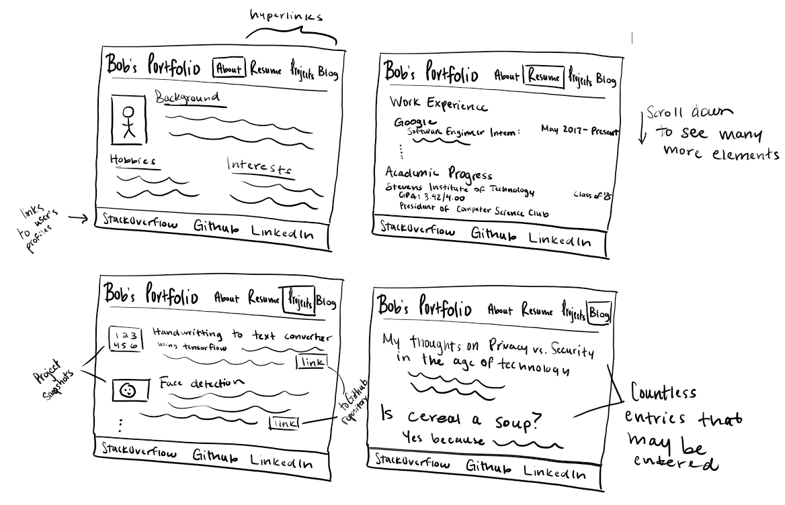
Preliminary Sketch:
Notes:
We followed the preliminary sketch closely on some bits such as the separate subpages, and not so much on others like the Blog section, which we ultimately removed.

Slide 4


Slide 5
Why use particular html elements?
Receiving user data
  <radio>
  <button>
  <textarea>
  <form>
Portfolio layout and functionality
  <head>
  <link>
  <script>
  <h1,h2,h3...>
  <div>
  <p>
Notes:
We wanted to make sure our website was organized, proportional, and easy to navigate. So, we used tags such as (read tags)

Slide 6
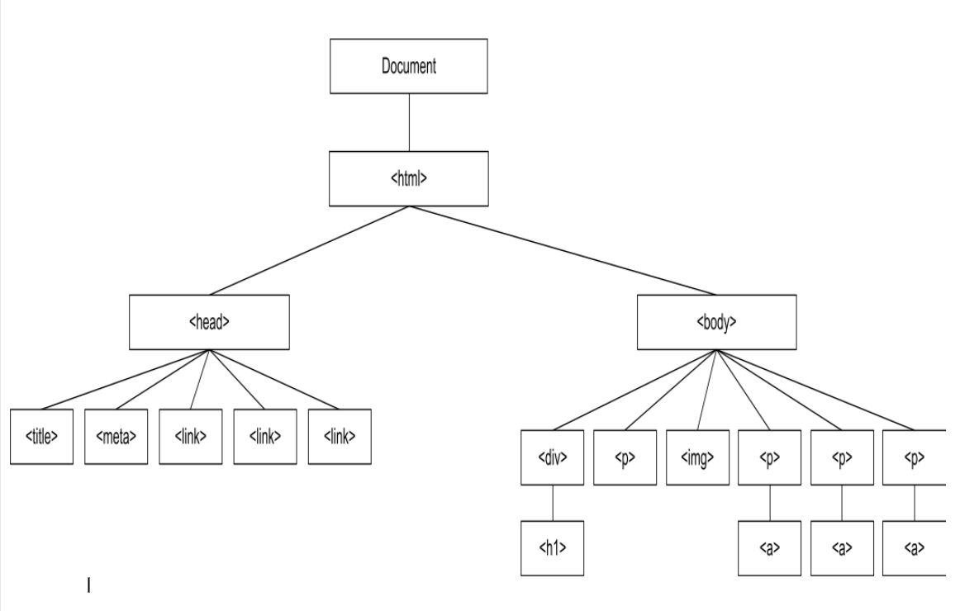
DOM Diagram: index.html

Slide 7
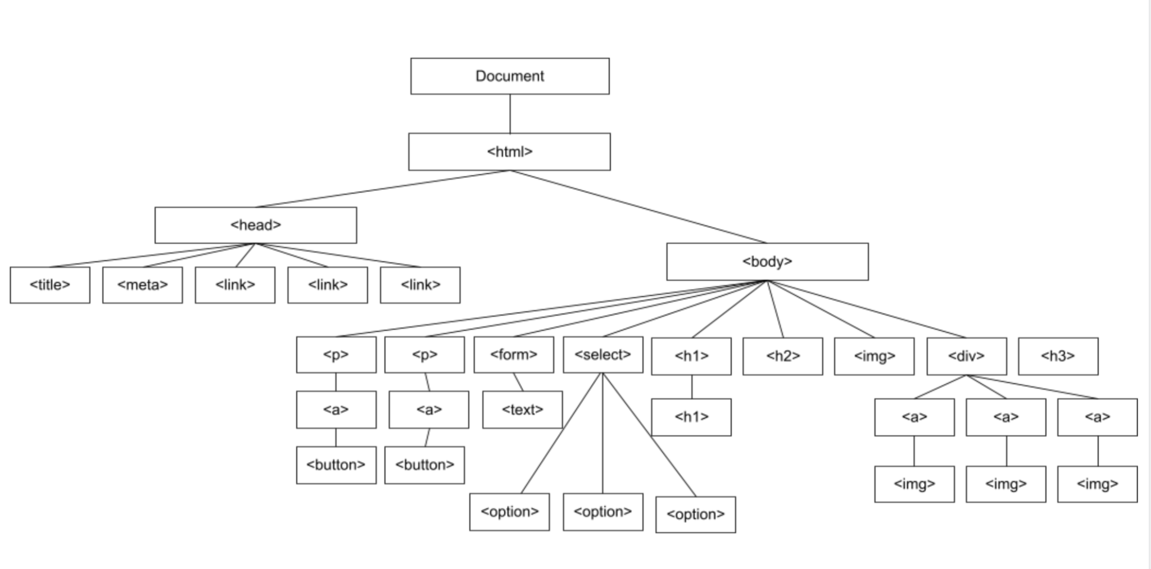
DOM Diagram: subpages

Slide 8
Why use particular CSS elements?
Basic styling
  Text-align
  Text-shadow
  Background-color
  Color
  Font-size, font-family
  Outline-style
  Outline-color
Design
  Margin
  Padding
  Overflow
  Max-width
  Display
  Border-radius
Notes:
CSS is the way to make a website look presentable, so we modified tags using (read styles)

Slide 9
Why use particular JS elements?
Basic form manipulation:
  .setAttribute()
  .insertAdjacentHTML()
  .createObjectURL()
  .innerHTML
  .concat()
Event handling:
  onclick
  onchange
Notes:
​​The point of our website was to allow for maximum user customization, so we used JavaScript functions such as (read functions)

Slide 10
Contributions:
Dimitri: Subpages (e.g. About, Resume, etc.)
Andrew: Pages (e..g, Template Overview, Minimalist, etc.)
Justin: Editor and CSS Stylist
Anthony: CSS Stylist/Media Creator

Slide 11
GitHub Repo
https://github.com/Andrewnar/CS-146
Functional on Safari, Chrome, and all of your favorite browsers!

